Slide 1
VitalContext
HACKYEAH 2026 · SPORT & HEALTHCARE (OPEN TASK)
Pre-visit intake that hands the doctor a brief where every fact cites its source.
Team Zabky · Dilnaz Ibrayeva, Polina Kuzmicheva, Fabiola Vivolo, Dmitriy Tereshchenko, Grigorii Shmelev
VitalContext · HackYeah 2026 · 1
github.com/DT-sudo/HACK_YEAH
Notes:
We are Team Don't Panic. VitalContext is pre-visit intake that hands the doctor a brief where every fact cites its source.

Slide 2




Constraints that people have visiting a doctor
Visits
Lost details
Time goes to re-reading the record and re-asking the story.
Patients forget symptoms, timelines and medicines.
Hidden medicines
Distrusted AI
Prescriptions from other clinics stay invisible.
Bots that diagnose create liability.
VitalContext · HackYeah 2026 · 2
Notes:
Visits are short, and time goes to re-reading the record and re-asking the story. Patients forget symptoms, timelines and medicines. Prescriptions from other clinics stay invisible. And bots that diagnose create liability, so clinicians do not trust them.

Slide 3
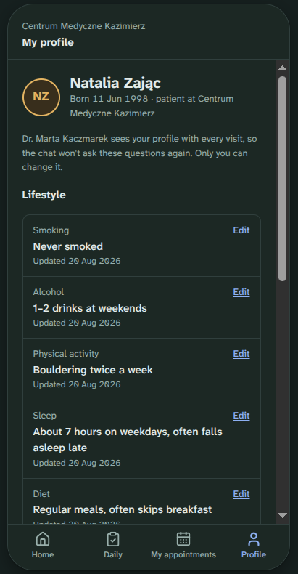
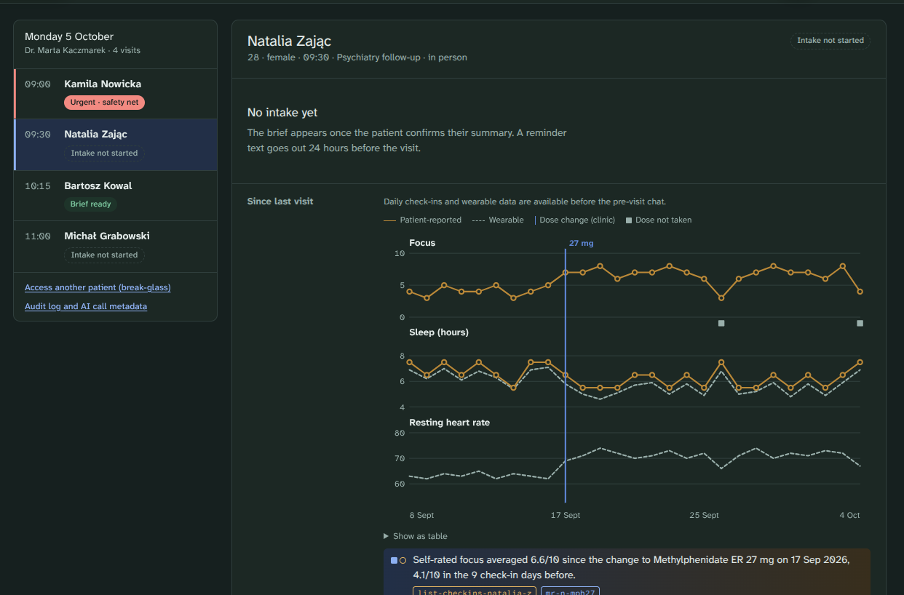
The patient chats before the visit; the doctor gets a sourced brief
[SCREENSHOT: doctor dashboard, pre-visit brief]
Guided intake chat
Type, speak or tap, in Polish or English.
Cited doctor brief
Every fact opens its source record.
One medication table
Clinic prescriptions plus patient-reported medicines.
Red-flag safety net
Rules stop the chat and show a 112 screen.
For people 30-55 y.o. going to a doctor regularly.
No diagnoses, risk scores or suggested actions, anywhere.
VitalContext · HackYeah 2026 · 3
Notes:
Before the visit the patient goes through a guided intake chat: type, speak or tap, in Polish or English. The doctor gets a cited brief where every fact opens its source record, with one medication table combining clinic prescriptions and patient-reported medicines. Red-flag rules stop the chat and show a 112 screen. There are no diagnoses, risk scores or suggested actions, anywhere.

Slide 4

Code owns safety and data; the LLM does three narrow tasks
LLM gateway
Patient app + Doctor dashboard
FastAPI services
Claude or offline deterministic engine
Safety · Context · Intake · Brief · Profile · Audit
Next.js, PL/EN
FHIR R4 store + PostgreSQL
Clinical records · users and audit log
The model sees only a pseudonymised context pack. Code validates every citation and discards any fact without a real source.
Next.js 16
TypeScript
Tailwind v4
FastAPI
Python 3.13
FHIR R4
PostgreSQL
Redis
Docker
All patients are synthetic. AI use disclosed.
VitalContext · HackYeah 2026 · 4
Notes:
Two Next.js front ends, the patient app and the doctor dashboard, talk to FastAPI services: Safety, Context, Intake, Brief, Profile and Audit. Those services call an LLM gateway, Claude or an offline deterministic engine, and a FHIR R4 store for clinical records plus PostgreSQL for users and the audit log. The model sees only a pseudonymised context pack. Code validates every citation and discards any fact without a real source. All patients are synthetic, and AI use is disclosed.

Slide 5
Built against the five criteria
30%
Idea & Innovation
Guided intake + clinic history + patient profile, with every AI statement grounded in a source.
20%
Relation to Category
Appointment preparation and doctor–patient communication; lifestyle and activity are part of the clinical picture.
20%
Practical Applicability
Clinic-operated, the common healthcare data format, so it can plug into existing clinic systems instead of needing a custom integration.
20%
Design
Two purpose-built interfaces, a calm mobile patient app and a dense doctor dashboard.
10%
Completeness
End-to-end flow runs today on synthetic data with one command; test suite included.
VitalContext · HackYeah 2026 · 6
Notes:
We built against the five judging criteria. Idea and innovation: guided intake plus clinic history plus patient profile, with every AI statement grounded in a source. Category: appointment preparation and doctor–patient communication. Applicability: clinic-operated, standard FHIR data, GDPR and regulatory path designed in from the start. Design: two purpose-built interfaces. Completeness: the end-to-end flow runs today on synthetic data with one command. Next: server-side speech-to-text, mObywatel login, e-prescription import, and a DPIA and MDR assessment.

Slide 6
Future plans
To expand the target audience
e-prescription import
Prediction based on DNA analysis
Accessibility features (i.e. for colorblind or blind people)
Multi-language support
VitalContext · HackYeah 2026 · 5
Notes:
Case 1: Anna describes a dry cough. The brief links it to her lisinopril prescription, and one click opens the original record. Case 2: an ADHD dose change. Daily check-ins and wearable data show what happened since the last visit. Where chat answers differ from the data, the doctor gets a prompt to ask, not a verdict.

